Slide 1
HP-II Workshop on Real-time Hydrological Information Systems
Module 3: Site Selection & Security
Mark Heggli, Meteorologist/Hydrologist
Expert Real-time Hydrology Information Systems
Innovative Hydrology, Inc.
Consultant to the World Bank

Slide 2
Examples that refer to products are intended for illustrative purposes only, and do not imply an endorsement or recommendation of any particular product

Slide 3
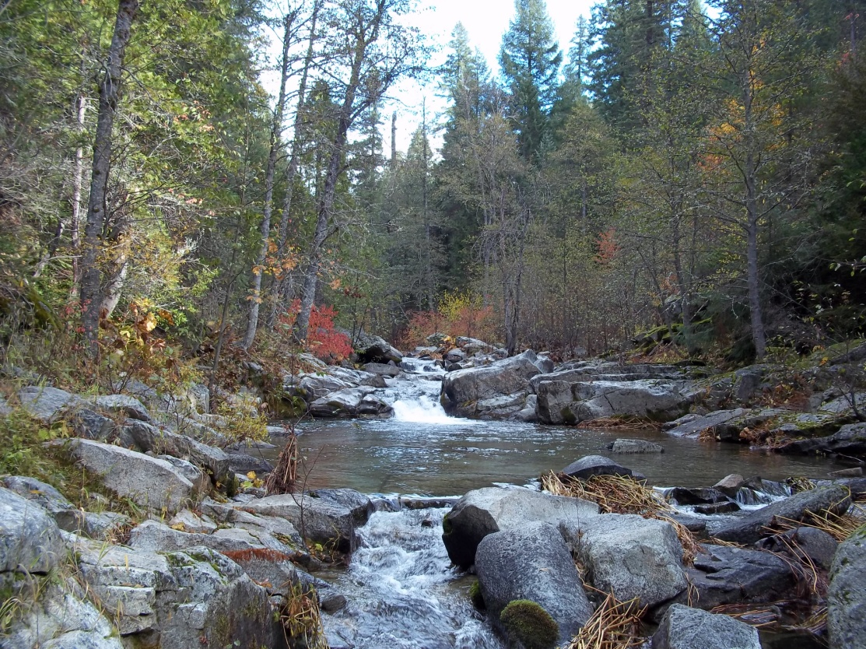
Site Selection and Security Consideration
Site selection
Define the Site Purpose
Site Survey/ Field Visit
Security considerations for all sites

Slide 4
Define The Site Purpose
Establish the purpose of the site
What are you trying to measure?
Water Level
Discharge
Water Temperature
Water Quality
Rainfall
Other
How crucial is the data?
Logging needs
Frequency of Data Collection
Consideration of future needs
Additional sensors, additional telemetry

Slide 5
Site Survey/Field Visit
Why is it important to complete a site survey?
Ease and safe accessibility
Understand the characteristics of the area being measured
Understanding the characteristics will help in the decision making of proper equipment to make accurate measurements
A mismatch between local conditions and appropriate technology can result in:
Poor quality of data
High maintenance requirements for both field and office procedures

Slide 6
Accessibility and Safety
Safe access to site
Road
Path
Boat
Aircraft
Minimization of risk during install, ongoing operation and maintenance
Personnel, sub-contractors, public

Slide 7
Water Level and Discharge Sites
Stream characteristics
Control
Upstream and downstream considerations
Contained and subterranean flow
Streambed and banks
Gauging sections

Slide 8
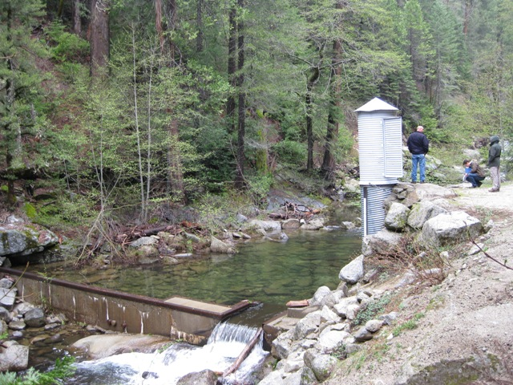
Control
What to look for in a control?
Control needs to be stable and sensitive
Minimum change in discharge with minimum change in stage
Cease to flow point should not be affected by sedimentation or weed growth
Try to find a site with an existing natural control
Types of Control
Natural control
Man made control

Slide 9
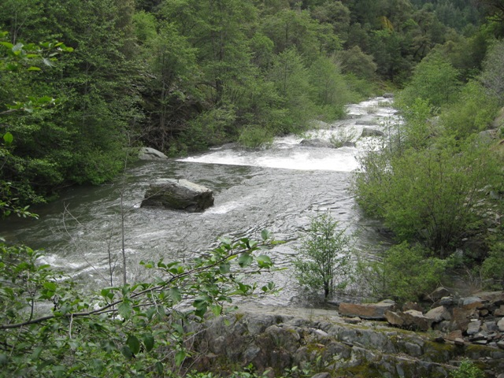
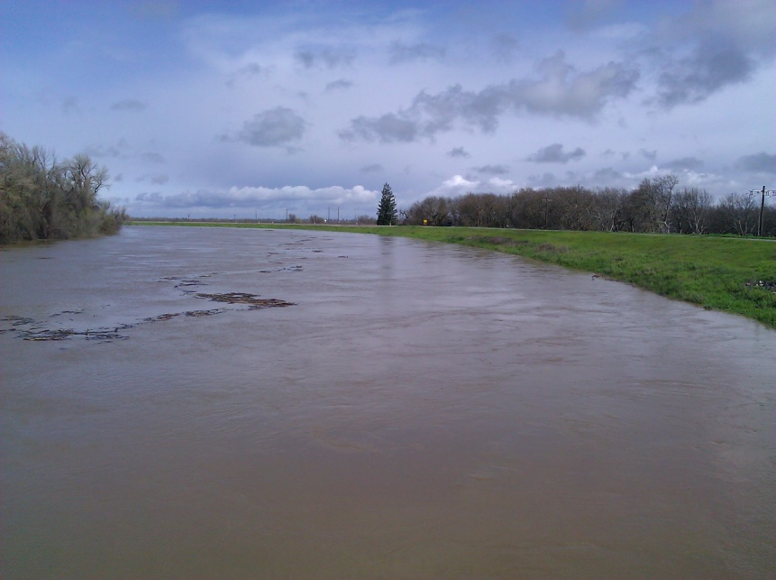
Upstream and Downstream Considerations
Straight section of stream
According to the WMO, the general course of the stream is straight for about 10 times the stream width, upstream and downstream from the gauge site if the control is a river reach (channel control).
Approach velocities are evenly distributed
Avoid cross-section where sediment deposition/scour is prevalent
Downstream Effects
Evaluate downstream effects (tidal effects, water shortages, future civil works/dams)

Slide 10
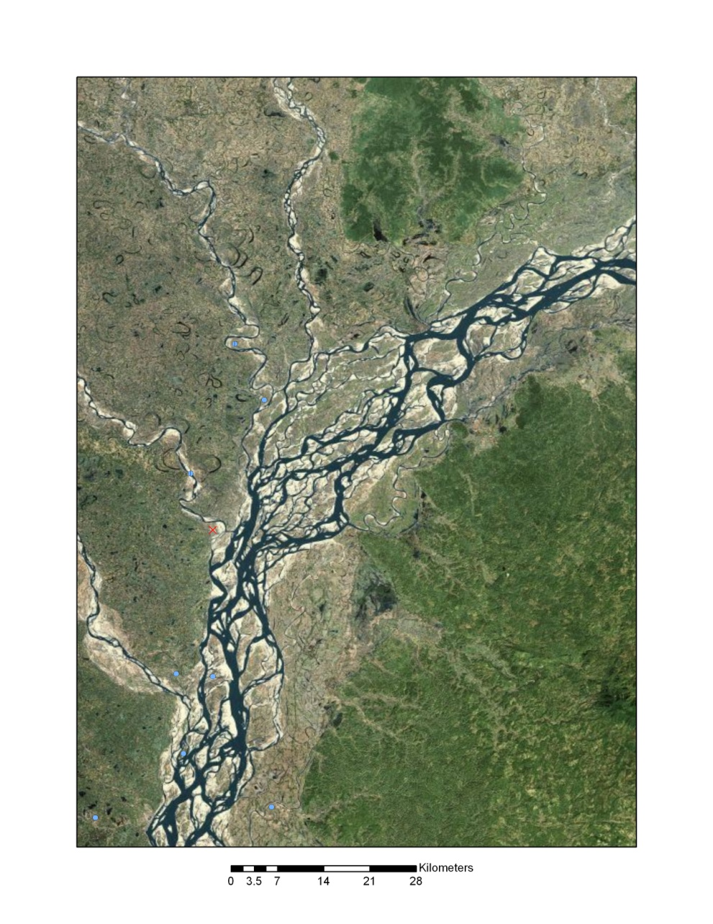
Contained and Subterranean Flow
Contained Flow
Section needs to contain all flow including maximum flood flow
No possibility of over bank or side channel flow
Subterranean Flow
Evaluation should include possibility of subterranean upstream, causing bypassing of flow (prevalent in underground mining areas)

Slide 11
Stable Stream Bed and Banks
Stable Stream Bed
Minimal infill or scour
Stable Stream Banks
Avoid locations with bank scour or erosion

Slide 12
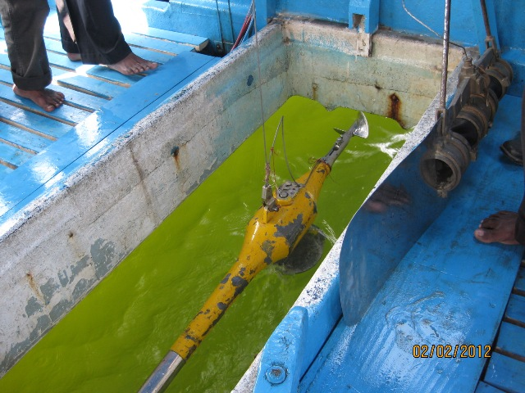
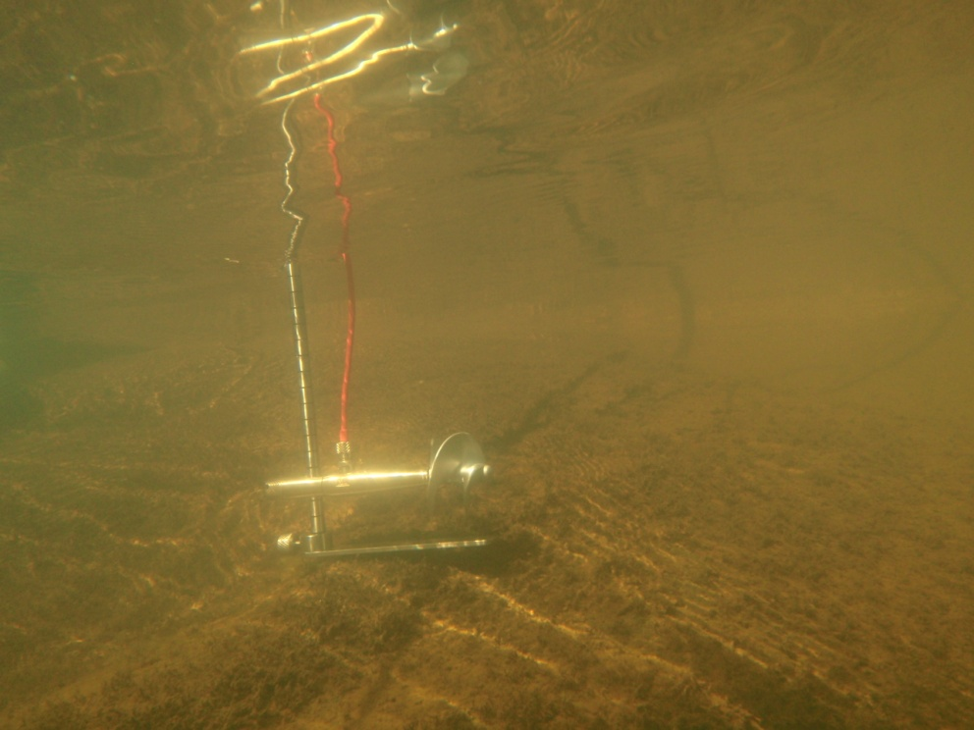
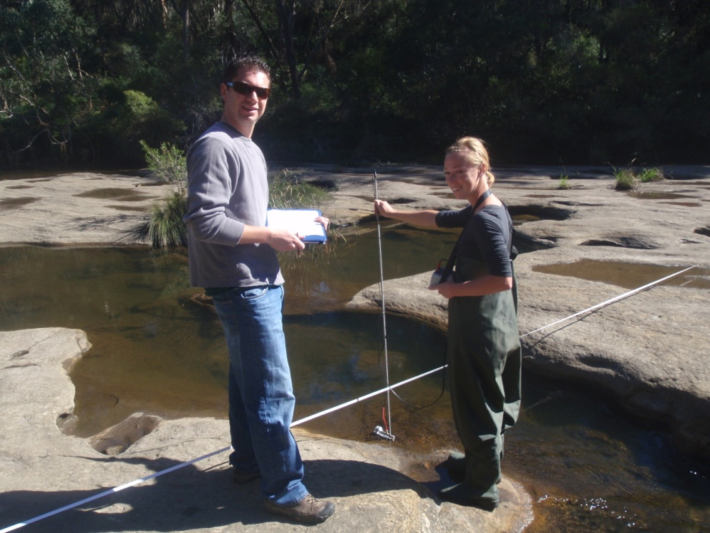
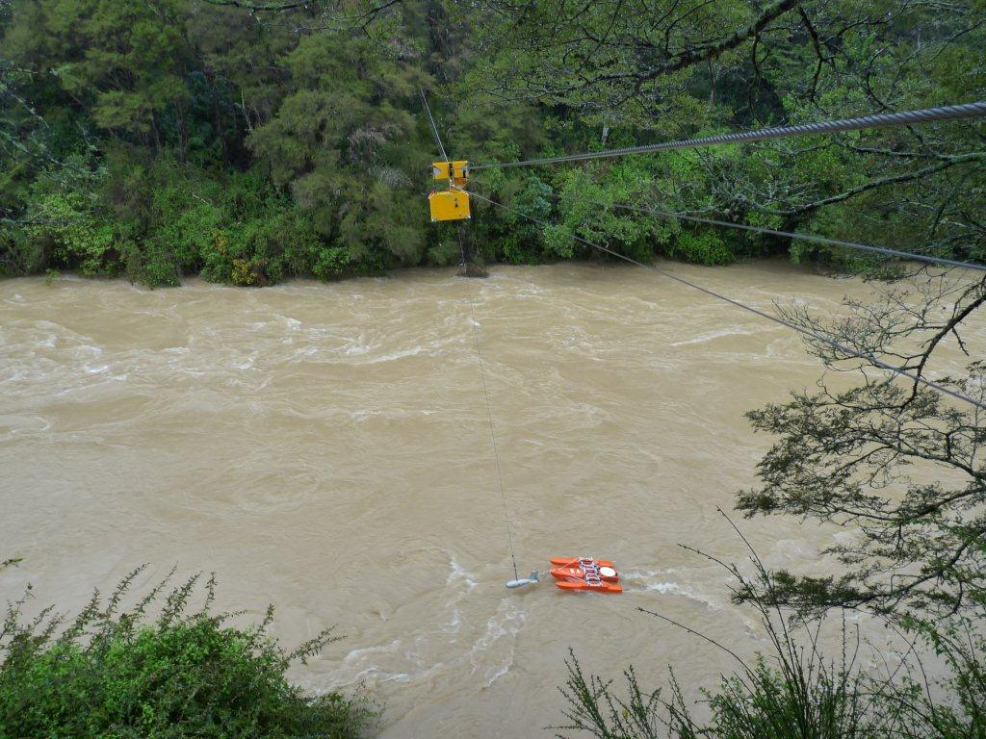
Gauging Sections
Gauging Sections
Feasibility
Low flow wading
Boat measurement
Unmanned cableways

Slide 13
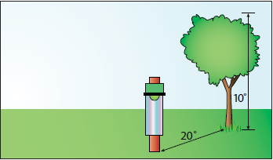
Rainfall Site Selection
Obstruction
Non windy area
Not on top of a mountain
Flat surface, no slopes
Height of gauge
1 m is standard according to WMO
Wind velocities increase with height
High enough to prevent splashing from the ground

Slide 14
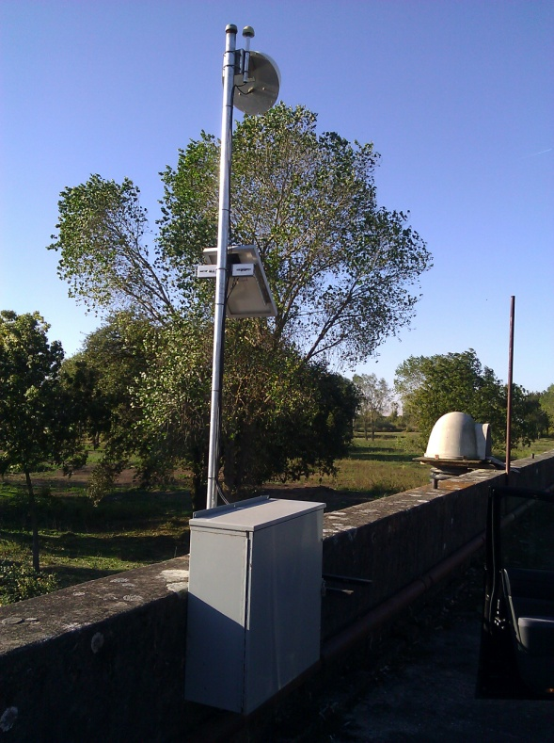
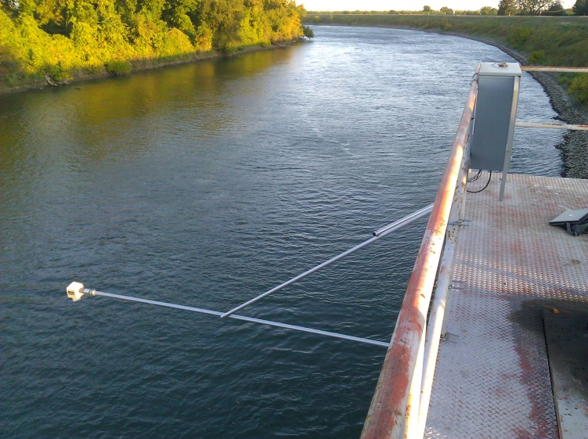
Location of Instrumentation
Power
AC
DC- Generator or Battery
Solar needs a clear access to sunlight
Telemetry
Landline
GPRS/GSM Coverage
Radio Link
Satellite Access
Housing of Equipment
Location of instrumentation must be above maximum flood

Slide 15
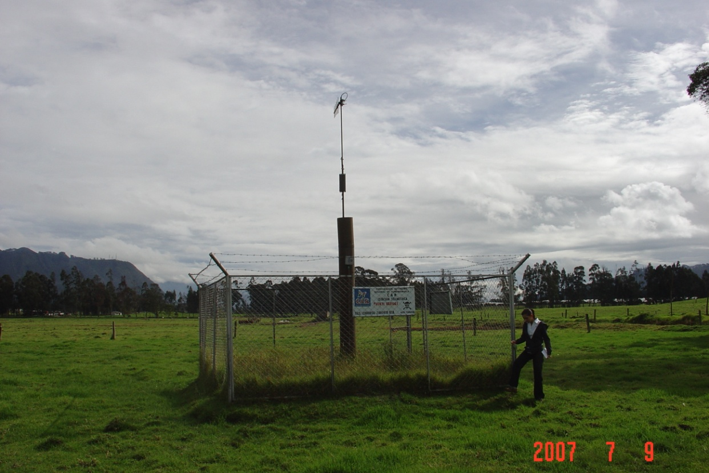
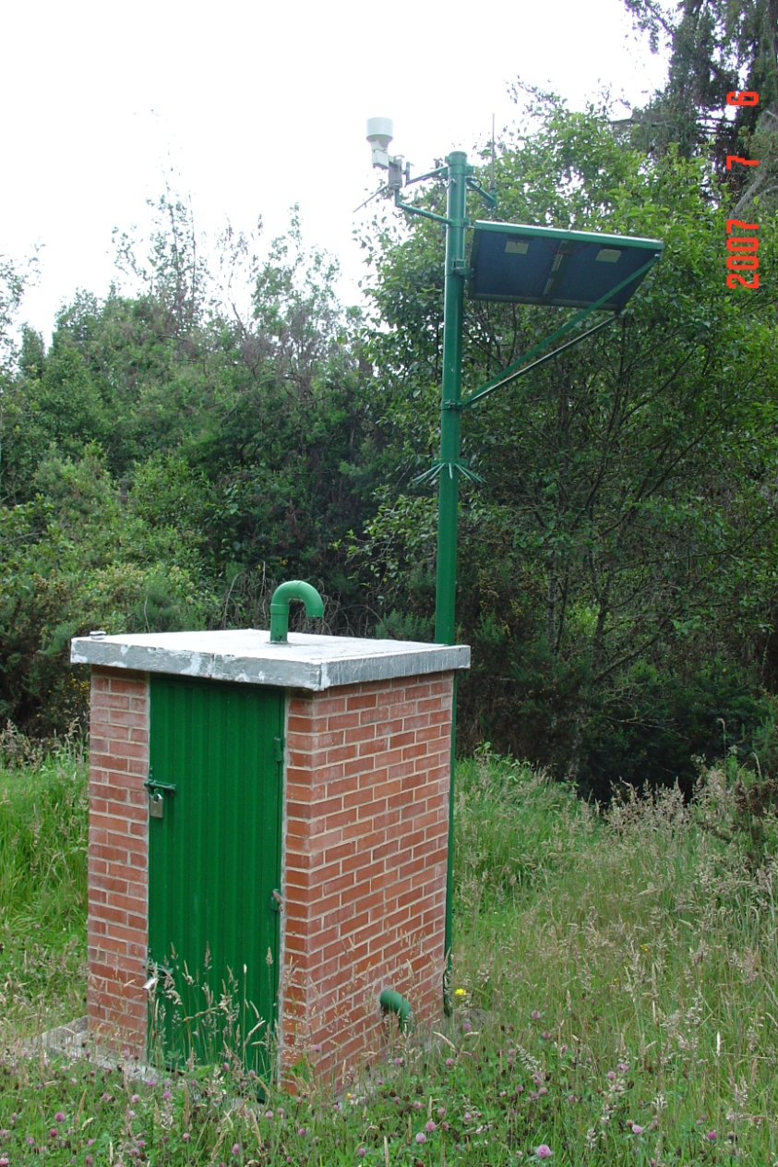
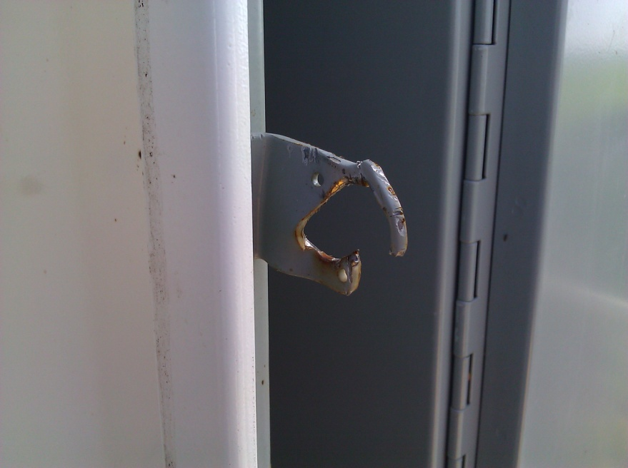
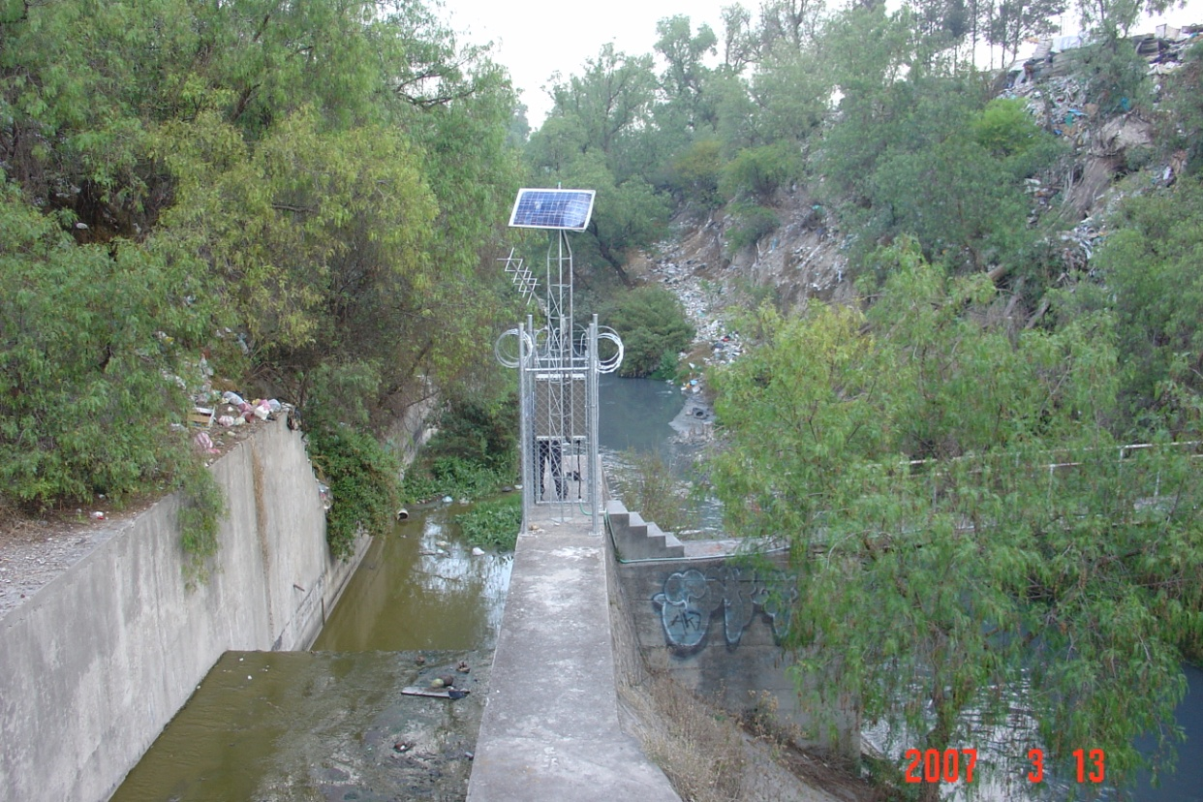
Security Considerations
All Sites
Locks
Fencing
Disguise

Slide 16
Suggestions
Rarely will an ideal site be found for a gauging station
Judgment must be exercised in choosing between adequate sites, each of which may have some shortcomings
Often adverse conditions may exist at all possible sites for installing a required gauging station and a poor site must be accepted
For example, all streams in a given region may have unstable beds and banks, which result in continually changing stage-discharge relations

Slide 17
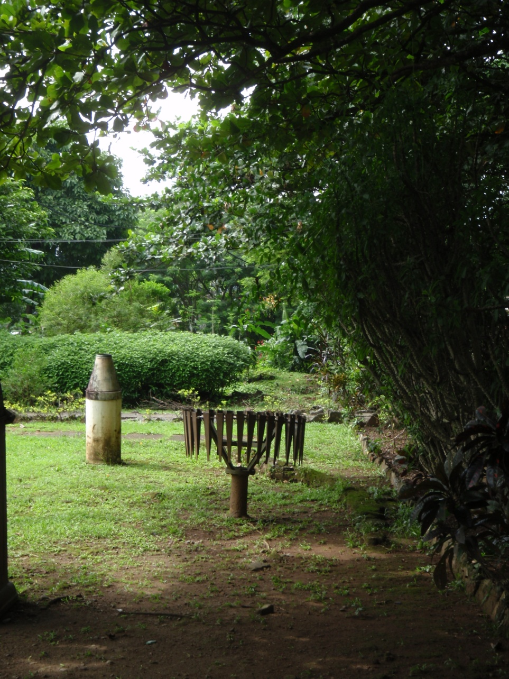
QUIZ
What is wrong with this location for a precipitation gauge?

Slide 18
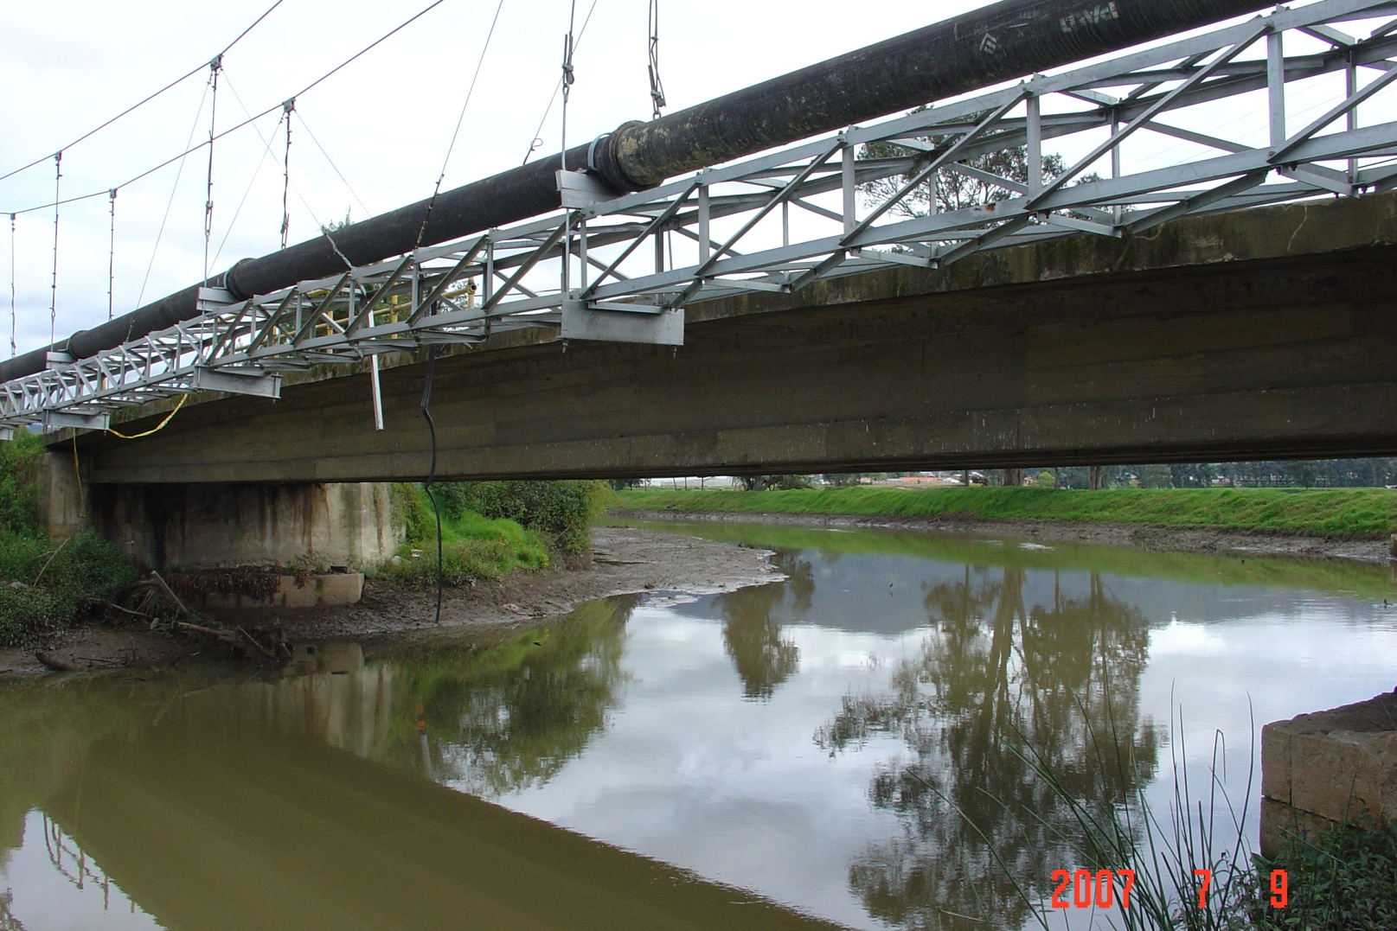
QUIZ
Is this a good location for a gauging site?

Slide 19
QUIZ
Poor choice in site selection can result in what?
✓
✗
✓
a. High maintenance requirements
b. Good equipment can fix poor choice in location
c. Poor quality of data

Slide 20
End of Module 3

